Slide 1

Chapter 2
Automotive Careers
and ASE Certification

Slide 2
Contents
The automotive technician
Preparing for a career in automotive technology
On-the-job traits
ASE certification
Entrepreneurship

Slide 3
The Automotive
Technician
Makes a living diagnosing, servicing, and repairing cars, vans, and light trucks
Must be highly skilled and well trained, being able to perform a wide variety of tasks

Slide 4
General Job Classifications
A wide variety of jobs are available in the automotive field
Many of these jobs involve troubleshooting, service, and repair

Slide 5
Service Station Attendant
Performs oil changes, grease jobs, and similar service tasks
Requires little mechanical experience
Provides an excellent learning experience

Slide 6
Apprentice
Learns automotive technology while working under the direction of an experienced technician
Performs tasks, such as:
  picking up parts
  cleaning parts
  maintaining tools
  helping with repairs

Slide 7
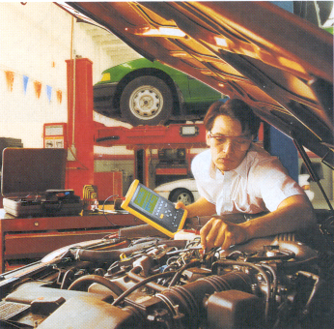
Apprentice
An excellent way to learn the trade

Slide 8
Specialized Technician
Expert on one automotive system
Because of the increasingly complex nature of today’s vehicles, the trend is toward specialization
It is much easier to learn to repair one system than all systems

Slide 9
Specialized Technician
Common areas of specialization:
  engines
  transmissions
  steering and suspension
  brakes
  electrical
  heating and cooling
  driveability and performance
  lubrication

Slide 10
Engine Technician
Troubleshoots, services, and repairs automobile engines
One of the most physically demanding automotive jobs
Requires an individual who can lift heavy parts and easily torque large fasteners

Slide 11
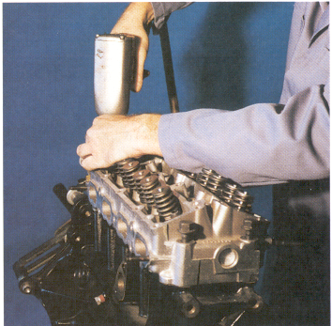
Engine Technician
Engine work requires a lot of skill.One mistake during assembly can be very costly

Slide 12
Transmission Technician
Works on automatic and manual transmissions, transaxles, clutches, and sometimes, rear axle assemblies
Must receive very specialized training and must frequently retrain

Slide 13
Steering and Suspension Technician
Responsible for checking, replacing, and adjusting steering and suspension components
Uses specialized equipment, such as the wheel alignment rack
May take care of tire and wheel problems

Slide 14
Brake Technician
Specializes in brake system service and repair
One of the easiest jobs to master
Jobs are available in both small and large shops, service stations, and tire outlets

Slide 15
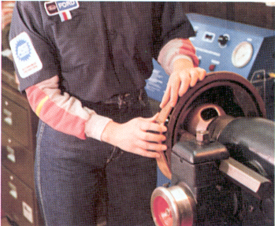
Brake Technician
This technician is machining a brake drum

Slide 16
Electrical System Technician
Must be able to test and repair lighting systems, charging systems, computer control systems, starting systems, and other electrical systems
Requires less physical strength than other areas

Slide 17
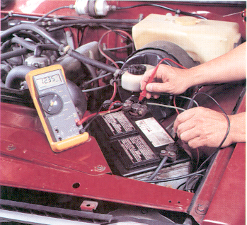
Electrical System Technician
This technician is using a digital voltmeter to measure battery voltage

Slide 18
Heating and Air Conditioning Technician
Must troubleshoot, service, and repair heaters, vents, and air conditioning systems
Installs new air conditioning systems in vehicles
  requires considerable skill

Slide 19
Driveability and Performance Technician
Must test and service engine fuel, ignition, and emission systems
  changes spark plugs, adjusts and repairs carburetors, fuel injection systems and ignition system components
Involves the use of special test equipment to keep engines in top running condition

Slide 20
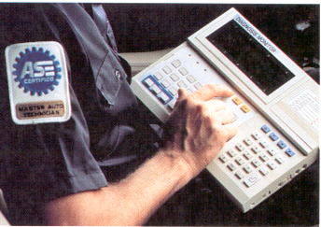
Driveability and Performance Technician
Using a diagnostic analyzer to find the source of engine performance problems

Slide 21
Lubrication Specialist
Changes engine oil, filters, and transmission fluid
Checks various fluid levels and performs “grease jobs”
  lubricates pivot points on suspension and steering systems

Slide 22
Master (General) Technician
Experienced professional who has mastered all the specialized areas
Capable of working on almost any part of a vehicle:
  engines, brakes, transmissions, axles, heaters, air conditioners, and electrical systems

Slide 23
Shop Supervisor
In charge of all the other technicians in the service facility
Must be able to help others troubleshoot problems in all automotive areas
Must communicate with the service manager, parts manager, and technicians

Slide 24
Service Manager
Responsible for the complete service and repair operation of a repair facility
Must use a wide range of abilities to coordinate the efforts of all the shop personnel
Handles customer complaints and ensures that the technicians are providing quality service

Slide 25
Auto Parts Specialist
Must have general knowledge of the components and systems of a vehicle
Uses customer requests, parts catalogs, price lists, and parts interchange sheets to quickly and accurately find needed parts

Slide 26
Service Writer (Advisor)
Prepares work orders for vehicles entering the shop
Greets customers and listens to descriptions of their problems
Fills out the repair order, describing what might be wrong

Slide 27
Service Dispatcher
Must select, organize, and assign technicians to perform each auto repair
Keeps track of all the repairs taking place in the shop

Slide 28
Auto Salesperson
Informs potential buyers of the features and equipment on a vehicle while trying to make a sale
Positions are also available selling automotive-related parts and equipment

Slide 29
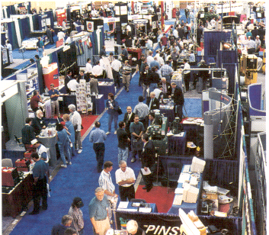
Auto Salesperson
Sales people are representing manufacturers of parts and tools at this convention

Slide 30
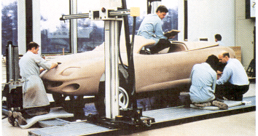
Automotive Designer
Has art training and can make sketches or models of new body and part designs
Employed by automobile manufacturers

Slide 31
Automotive Engineer
Designs new and improved automotive systems and parts
Uses math, physics, and other advanced technologies
Highly paid, college-trained individual with a working knowledge of the entire automobile

Slide 32
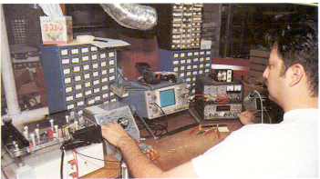
Automotive Engineer
Most engineers have a bachelor’s degree in a related discipline

Slide 33
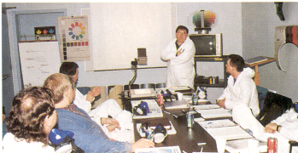
Automotive Instructor
Experienced technician, capable of sharing their knowledge effectively
Most instructors have a college degree

Slide 34
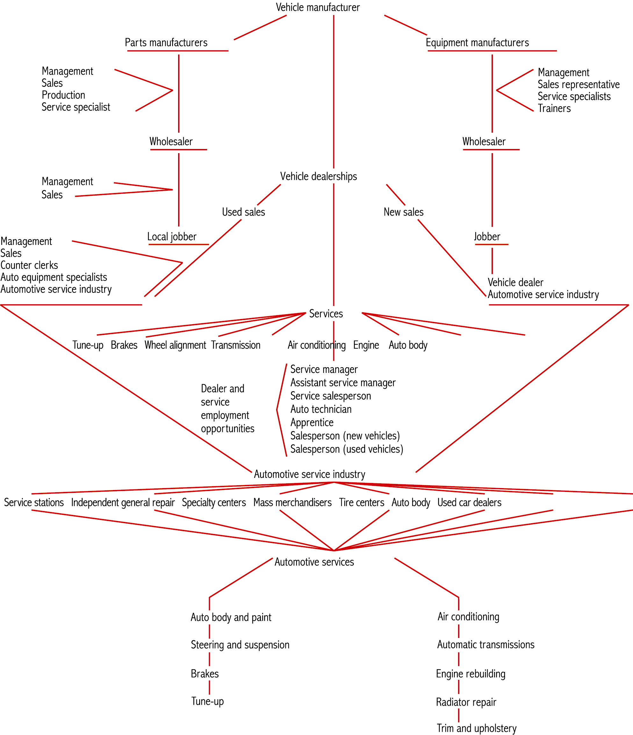
Automotive
Positions

Slide 35
Preparing for a Career
in
Automotive Technology

Slide 36
Career Preparations
Many of the basic skills needed to succeed are learned in the classroom
Automotive technicians must have above-average math and English skills
Good verbal skills are required to effectively communicate with customers and other technicians

Slide 37
Cooperative Training Programs
Allow you to earn school credit and a wage by working in a commercial repair shop
Ask your guidance counselor or automotive instructor about a training program in your school

Slide 38
ASE Certification
National Institute for Automotive Service Excellence is a nonprofit, nonaffiliated organization formed to help ensure the highest standards in automotive service
ASE directs an organized testing and certification program

Slide 39
ASE Certification
Program in which persons take written tests to prove their knowledge of automotive technology
Tests are voluntary
Technicians take the tests for personal benefit and to show their employers and customers they are fully qualified

Slide 40
Test Categories
There are eight automotive categories:
  engine repair
  automatic transmission/transaxle
  manual drive train and axles
  suspension and steering
  brakes
  electrical/electronic systems
  heating and air conditioning
  engine performance

Slide 41
Test Categories
You can take any one or all of these tests
Only four tests can be taken at one testing session (200 questions maximum)

Slide 42
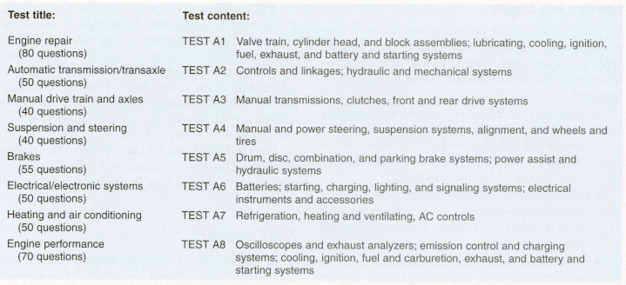
Automotive Test Categories

Slide 43
Certification Status
ASE-certified automotive technician status is granted for each ASE test passed
ASE-certified master automobile technician status is granted when all eight test areas have been passed

Slide 44
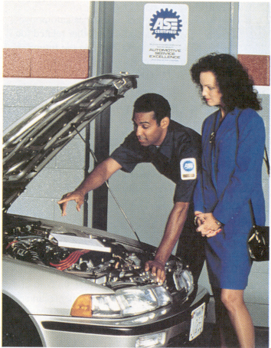
Certification Status
Sleeve or shirt patches and certificates are awarded for each test passed

Slide 45
Applying for ASE Tests
To receive certification, the applicant must also have at least two years of experience as an automobile or truck technician
Formal training may be substituted for all or part of the experience requirement
  when registering, include a copy of your transcript or a certificate verifying your training or apprenticeship

Slide 46
Applying for ASE Tests
To acquire a registration booklet, send your name and address to:
  ASE Registration Booklet
  P.O. Box 591
  Herndon, VA 20172-0591
Fill out the registration form found inside and mail it as directed
Fees will apply

Slide 47
Applying for ASE Tests
Tests are given in the spring and fall of each year
Tests are located at over 300 facilities throughout the United States
Most test centers are located at local colleges, high schools, or vocational schools

Slide 48
Test-Taking Techniques
Read each question carefully before deciding on a proper answer
Select the most correct response
Knowledge of general trade specifications will be required
Each test is usually about four hours

Slide 49
Test Tips
Read the statements or questions slowly
Analyze the statement or question
Analyze the question as if you were the technician trying to fix the car
When two technicians give statements concerning a problem, try to decide if either is incorrect

Slide 50
Test Tips
Your first thought is usually the correct response
Do not waste time on any one question
Visualize yourself performing a test or repair when trying to answer a question

Slide 51
Types of Test Questions
ASE tests are designed to measure your knowledge of three things:
  operation of various systems and components
  diagnosis and testing of systems and components
  repair of systems and components

Slide 52
One-Part Questions
  1. Which of the following components ignites the fuel in a gasoline engine?
  (A) Injector.
  (B) Valve.
  (C) Spark plug.
  (D) Glow plug.
The correct answer is (C) Spark plug.

Slide 53
Two-Part Questions
  1. Technician A says a locking rear differential assembly can be refilled with regular gear oil.
  Technician B says the differential assembly allows the vehicle to turn corners without wheel hop. Who is right?
  (A) A only.
  (B) B only.
  (C) Both A & B.
  (D) Neither A nor B.
The correct answer is (B) B only

Slide 54
Negative Questions
  1. An engine contains all of the following bearings except:
  (A) connecting rod bearings.
  (B) main crankshaft bearings.
  (C) camshaft bearings.
  (D) reverse idler bearings.
The correct answer is (D) reverse idler bearings.

Slide 55
Completion Questions
  1. A torque wrench is used to measure:
  (A) twisting force on fasteners.
  (B) shear applied to fasteners.
  (C) horsepower applied to fasteners.
  (D) transmission slip yoke angles.
The correct answer is (A) twisting force on fasteners

Slide 56
Test Results
Test scores will be mailed to your home a few weeks after you have completed the test
Only you will find out how you did on the tests

Slide 57
Recertification Tests
You must take a recertification test every five years to maintain your certification
Test questions concentrate on recent developments
If you allow your certification to lapse, you must take the regular certification test(s) to regain your certification

Slide 58
Entrepreneurship
An entrepreneur is someone who starts a business, such as a muffler shop, tune-up shop, parts house, or similar facility

Slide 59
Entrepreneurial Qualities
To be a good entrepreneur, you must be able to organize all aspects of the business:
  bookkeeping
  payroll
  facility planning
  hiring
Most successful entrepreneurs have leadership qualities

